Slide 1


LEADERSHIP
UNIT 8

Slide 2
LEARNING OUTCOME
Define leader and leadership.
Compare and contrast early theories of leadership.
Describe the three major contingency theories of leadership.
Describe contemporary views of leadership.
Discuss contemporary issues affecting leadership.

Slide 3
WHO ARE LEADERS AND WHAT IS LEADERSHIP?
Leader - Someone who can influence others and who has managerial authority.
Leadership - What leaders do; the process of influencing a group to achieve goals.
Ideally, all managers should be leaders.
Notes:
Let’s begin by clarifying who leaders are and what leadership is. Our definition of a leader is someone who can influence others and who has managerial authority. Leadership is a process of leading a group and influencing that group to achieve its goals. It’s what leaders do.
Are all managers leaders? Because leading is one of the four management functions, yes, ideally, all managers should be leaders. Thus, we’re going to study leaders and leadership from a managerial perspective.

Slide 4
EARLY LEADERSHIP THEORIES
Trait Theories (1920s -1930s)
Research focused on identifying personal characteristics that differentiated leaders from non-leaders was unsuccessful.
It proved impossible to identify a set of traits that would always differentiate a leader (the person) from a nonleader.
Notes:
Leadership research in the 1920s and 1930s focused on isolating leader traits— that is, characteristics—that would differentiate leaders from nonleaders. Some of the traits studied included physical stature, appearance, social class, emotional stability, fluency of speech, and sociability. Despite the best efforts of researchers, it proved impossible to identify a set of traits that would always differentiate a leader (the person)
from a nonleader.

Slide 5
EXHIBIT 18-1 EIGHT TRAITS ASSOCIATED WITH LEADERSHIP
Notes:
The eight traits shown to be associated with effective leadership are described briefly in Exhibit 18-1.

Slide 6
EXHIBIT 18-1 EIGHT TRAITS ASSOCIATED WITH LEADERSHIP (CONT.)
Notes:
The eight traits shown to be associated with effective leadership are described briefly in Exhibit 18-1.

Slide 7
EARLY LEADERSHIP THEORIES (CONT.)
Behavioral theories - leadership theories that identify behaviors that differentiated effective leaders from ineffective leaders.
University of Iowa Studies
Identified three leadership styles
Autocratic
Democratic
Laissez-faire
Notes:
Researchers hoped that the behavioral theories approach would provide more definitive answers about the nature of leadership than did the trait theories.
The University of Iowa studies explored three leadership styles to find which was the most effective.

Slide 8
UNIVERSITY OF IOWA STUDIES (CONT.)
Autocratic style - A leader who dictates work methods, makes unilateral decisions, and limits employee participation
Democratic style - A leader who involves employees in decision making, delegates authority, and uses feedback as an opportunity for coaching employees
Laissez-faire style - A leader who lets the group make decisions and complete the work in whatever way it sees fit
Notes:
The autocratic style described a leader who dictated work methods, made unilateral decisions, and limited employee participation. The democratic style described a leader who involved employees in decision making, delegated authority, and used feedback as an opportunity for coaching employees. Finally, the laissez-faire style leader let the group make decisions and complete the work in whatever way it saw fit. The researchers’ results seemed to indicate that the democratic style contributed to both good quantity and quality of work.

Slide 9
EARLY LEADERSHIP THEORIES (CONT.)
The Ohio State Studies
Identified two dimensions of leader behavior:
Initiating structure: the role of the leader in defining his or her role and the roles of group members.
Consideration: the leader’s mutual trust and respect for group members’ ideas and feelings.
Notes:
The Ohio State studies identified two important dimensions of leader behavior. The first was called initiating structure, which referred to the extent to which a leader defined his or her role and the roles of group members in attaining goals. It included behaviors
that involved attempts to organize work, work relationships, and goals. The second was called consideration, which was defined as the extent to which a leader had work relationships characterized by mutual trust and respect for group members’ ideas and feelings. A leader who was high in consideration helped group members with personal problems, was friendly and approachable, and treated all
group members as equals. He or she showed concern for (was considerate of) his or her followers’ comfort, well-being, status, and satisfaction.

Slide 10
RESULTS OF OHIO STATE STUDIES
High consideration/high structure leaders generally, but not always, achieved high scores on group task performance and satisfaction.
Evidence indicated that situational factors appeared to strongly influence leadership effectiveness.
Notes:
Research found that a leader who was high in both initiating structure and consideration (a high–high leader) sometimes achieved high group task performance and high group member satisfaction, but not always.

Slide 11
UNIVERSITY OF MICHIGAN STUDIES
Identified two dimensions of leader behavior:
Employee oriented: emphasizing personal relationships
Production oriented: emphasizing task accomplishment
Research findings:
Leaders who are employee oriented are strongly associated with high group productivity and high job satisfaction.
Notes:
Leadership studies conducted at the University of Michigan at about the same time as those done at Ohio State also hoped to identify behavioral characteristics of leaders that were related to performance effectiveness. The Michigan group also came up with two dimensions of leadership behavior, which they labeled employee oriented and production oriented.
Leaders who were employee oriented were described as emphasizing interpersonal relationships. The production-oriented leaders, in contrast, tended to emphasize the task aspects of the job. Unlike the other studies, the Michigan researchers concluded that leaders who were employee oriented were able to get high group productivity and high group member satisfaction.

Slide 12
THE MANAGERIAL GRID
Managerial grid - a two-dimensional grid for appraising leadership styles
Places managerial styles in five categories:
Impoverished management
Task management
Middle-of-the-road management
Country club management
Team management
Notes:
The behavioral dimensions from these early leadership studies provided the basis for the development of a two-dimensional grid for appraising
leadership styles. This managerial grid used the behavioral dimensions “concern for people” (the vertical part of the grid) and “concern for production” (the horizontal part of the grid) and evaluated a leader’s use of these behaviors, ranking them on a scale from 1 (low) to 9 (high).
Although the grid had 81 potential categories into which a leader’s behavioral style might fall, only five styles were named: impoverished management (1,1 or low concern for production, low concern for people), task management (9,1 or high concern for production, low concern for people), middle-of-the-road management (5,5 or medium concern for production, medium concern for people), country club management (1,9 or low concern for production, high concern for people), and team management (9,9 or high concern for production, high concern
for people). Of these five styles, the researchers concluded that managers performed best when using a 9,9 style.

Slide 13
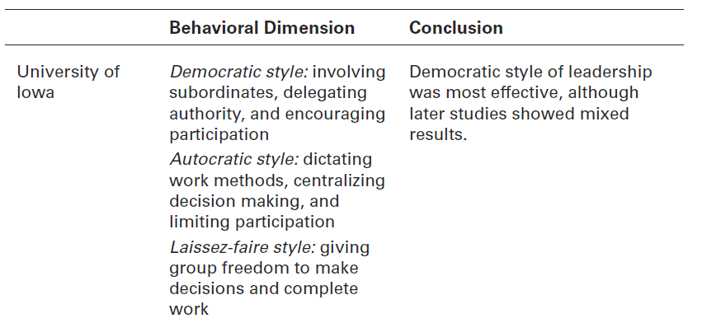
EXHIBIT 18-2 BEHAVIORAL THEORIES OF LEADERSHIP
Notes:
The four main leader behavior studies are summarized in Exhibit 18-2.

Slide 14
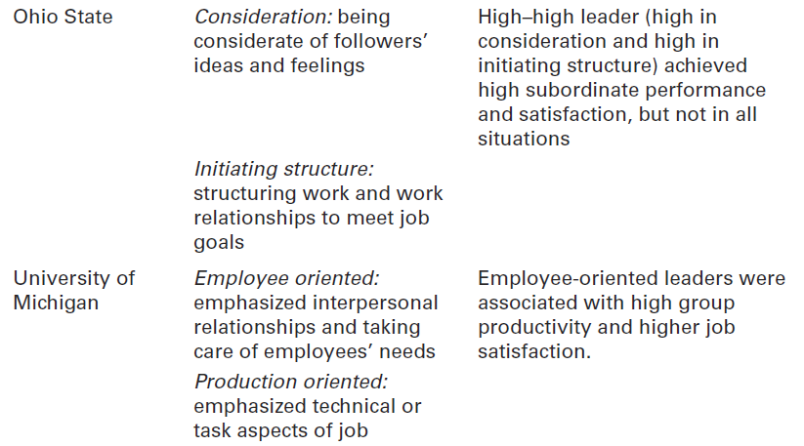
EXHIBIT 18-2 BEHAVIORAL THEORIES OF LEADERSHIP (CONT.)

Slide 15
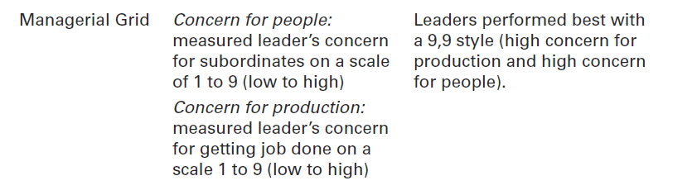
EXHIBIT 18-2 BEHAVIORAL THEORIES OF LEADERSHIP (CONT.)

Slide 16
CONTINGENCY THEORIES OF LEADERSHIP
Fiedler contingency model - a leadership theory proposing that effective group performance depends on the proper match between a leader’s style and the degree to which the situation allows the leader to control and influence
Notes:
The first comprehensive contingency model for leadership was developed by Fred Fiedler. The Fiedler contingency model proposed that effective group performance depended on properly matching the leader’s style and the amount of control and influence in the situation. The model was based on the premise that a certain leadership style would be most effective in different types of situations. The keys
were to (1) define those leadership styles and the different types of situations, and then (2) identify the appropriate combinations of style and situation.

Slide 17
THE FIEDLER MODEL (CONT.)
Least-preferred coworker (LPC) questionnaire - a questionnaire that measures whether a leader is task or relationship oriented
Notes:
Fiedler proposed that a key factor in leadership success was an individual’s basic leadership style, either task oriented or relationship oriented. To measure a leader’s style, Fiedler developed the least-preferred coworker (LPC) questionnaire. This questionnaire contained 18 pairs of contrasting adjectives—for example, pleasant– unpleasant, cold–warm, boring–interesting, or friendly–unfriendly. Respondents were
asked to think of all the coworkers they had ever had and to describe that one person they least enjoyed working with by rating him or her on a scale of 1 to 8 for each of the 18 sets of adjectives (the 8 always described the positive adjective out of the pair and the 1 always described the negative adjective out of the pair).

Slide 18
THE FIEDLER MODEL (CONT.)
Leader–member relations: the degree of confidence, trust, and respect employees had for their leader; rated as either good or poor.
Task structure: the degree to which job assignments were formalized and structured; rated as either high or low.
Position power: the degree of influence a leader had over activities such as hiring, firing, discipline, promotions, and salary increases; rated as either strong or weak.
Notes:
After an individual’s leadership style had been assessed through the LPC, it was time to evaluate the situation in order to be able to match the leader with the situation. Fiedler’s research uncovered three contingency dimensions that defined the key situational factors in leader effectiveness.
• Leader–member relations: the degree of confidence, trust, and respect employees had for their leader; rated as either good or poor.
• Task structure: the degree to which job assignments were formalized and structured; rated as either high or low.
• Position power: the degree of influence a leader had over activities such as hiring, firing, discipline, promotions, and salary increases; rated as either strong or weak.

Slide 19
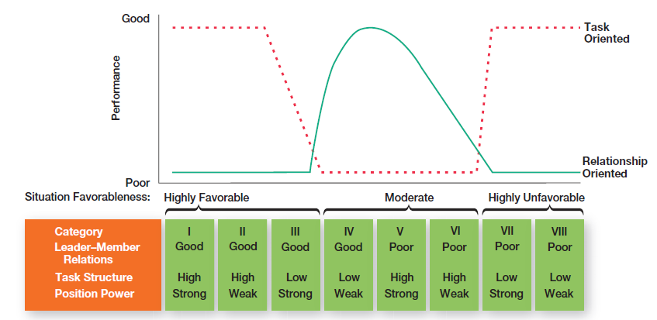
EXHIBIT 18-3 THE FIEDLER MODEL
Notes:
Each leadership situation was evaluated in terms of these three contingency variables, which when combined produced eight possible situations that were either favorable or unfavorable for the leader. (See the bottom of the chart in Exhibit 18-3.) Situations I, II, and III were classified as highly favorable for the leader. Situations IV, V, and VI were moderately favorable for the leader. And situations VII and VIII were
described as highly unfavorable for the leader.

Slide 20
HERSEY AND BLANCHARD’S SITUATIONAL LEADERSHIP THEORY (SLT)
Situational leadership theory (SLT) - a leadership contingency theory that focuses on followers’ readiness
Readiness: the extent to which followers have the ability and willingness to accomplish a specific task
Notes:
Paul Hersey and Ken Blanchard developed a leadership theory that has gained a strong following among management development specialists. This model, called situational leadership theory (SLT), is a contingency theory that focuses on followers’ readiness.
Regardless of what the leader does, the group’s effectiveness depends on the actions of the followers. This important dimension
has been overlooked or underemphasized in most leadership theories. And readiness, as defined by Hersey and Blanchard, refers to the extent to which people have the ability and willingness to accomplish a specific task.

Slide 21
SLT LEADERSHIP STYLES
Telling (high task–low relationship): The leader defines roles and tells people what, how, when, and where to do various tasks.
Selling (high task–high relationship): The leader provides both directive and supportive behavior.
Notes:
SLT uses the same two leadership dimensions that Fiedler identified: task and relationship behaviors. However, Hersey and Blanchard go a step further by considering each as either high or low and then combining them into four specific leadership styles described as follows:
• Telling (high task–low relationship): The leader defines roles and tells people what, how, when, and where to do various tasks.
• Selling (high task–high relationship): The leader provides both directive and supportive behavior.

Slide 22
SLT LEADERSHIP STYLES (CONT.)
Participating (low task–high relationship): The leader and followers share in decision making; the main role of the leader is facilitating and communicating.
Delegating (low task–low relationship): The leader provides little direction or support.
Notes:
Participating (low task–high relationship): The leader and followers share in decision making; the main role of the leader is facilitating and communicating.
Delegating (low task–low relationship): The leader provides little direction or support.

Slide 23
FOUR STAGES OF FOLLOWER READINESS
R1: People are both unable and unwilling to take responsibility for doing something. Followers aren’t competent or confident.
R2: People are unable but willing to do the necessary job tasks. Followers are motivated but lack the appropriate skills.
Notes:
The final component in the model is the four stages of follower readiness:
R1: People are both unable and unwilling to take responsibility for doing something. Followers aren’t competent or confident.
R2: People are unable but willing to do the necessary job tasks. Followers are motivated but lack the appropriate skills.

Slide 24
FOUR STAGES OF FOLLOWER READINESS (CONT.)
R3: People are able but unwilling to do what the leader wants. Followers are competent, but don’t want to do something.
R4: People are both able and willing to do what is asked of them.
Notes:
R3: People are able but unwilling to do what the leader wants. Followers are competent, but don’t want to do something.
R4: People are both able and willing to do what is asked of them.

Slide 25
PATH-GOAL MODEL
Path-goal theory – a leadership theory that says the leader’s job is to assist followers in attaining their goals and to provide direction or support needed to ensure that their goals are compatible with the goals of the group or organization.
Notes:
Another approach to understanding leadership is path-goal theory, which states that the leader’s job is to assist followers in attaining their goals and to provide direction or support needed to ensure that their goals are compatible with the goals of the group or organization. Developed by Robert House, path-goal theory takes key elements from the expectancy theory of motivation. The term path-goal is derived
from the belief that effective leaders remove the roadblocks and pitfalls so that followers have a clearer path to help them get from where they are to the achievement of their work goals.

Slide 26
PATH-GOAL MODEL (CONT.)
Four leadership behaviors
Directive leader: Lets subordinates know what’s expected of them, schedules work to be done, and gives specific guidance on how to accomplish tasks.
Supportive leader: Shows concern for the needs of followers and is friendly.
Notes:
House identified four leadership behaviors:
Directive leader: Lets subordinates know what’s expected of them, schedules work to be done, and gives specific guidance on how to accomplish tasks.
Supportive leader: Shows concern for the needs of followers and is friendly.

Slide 27
PATH-GOAL MODEL (CONT.)
Four leadership behaviors (cont.)
Participative leader: Consults with group members and uses their suggestions before making a decision.
Achievement oriented leader: Sets challenging goals and expects followers to perform at their highest level.
Notes:
Participative leader: Consults with group members and uses their suggestions before making a decision.
Achievement oriented leader: Sets challenging goals and expects followers to perform at their highest level.
In contrast to Fiedler’s view that a leader couldn’t change his or her behavior, House assumed that leaders are flexible and can display any or all of these leadership styles depending on the situation.

Slide 28
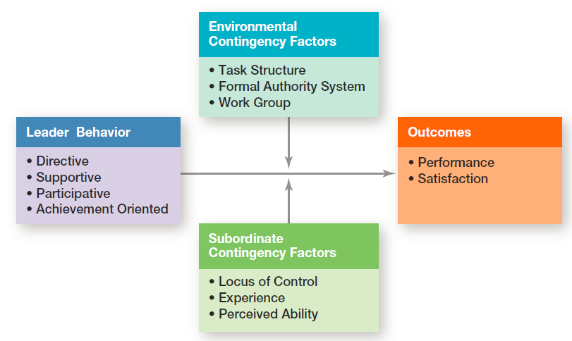
EXHIBIT 18-4 PATH-GOAL MODEL
Notes:
As Exhibit 18-4 illustrates, path-goal theory proposes two situational or contingency variables that moderate the leadership behavior–outcome relationship: those in the environment that are outside the control of the follower (factors including task structure, formal authority system, and the work group) and those that are part of the personal characteristics of the follower (including locus of control, experience, and perceived ability).

Slide 29
CONTEMPORARY VIEWS OF LEADERSHIP
Leader–member exchange theory (LMX) - the leadership theory that says leaders create in-groups and out-groups and those in the in-group will have higher performance ratings, less turnover, and greater job satisfaction
Notes:
Leader–member exchange theory (LMX) says leaders create in-groups and out-groups and those in the in-group will have higher performance ratings, less turnover, and greater job satisfaction. LMX theory suggests that early on in the relationship between a leader and a
given follower, a leader will implicitly categorize a follower as an “in” or as an “out.” That relationship tends to remain fairly stable over time. Leaders also encourage LMX by rewarding those employees with whom they want a closer linkage and punishing those with whom they do not.

Slide 30
CONTEMPORARY VIEWS OF LEADERSHIP (CONT.)
Transactional leaders - leaders who lead primarily by using social exchanges (or transactions)
Transformational leaders - leaders who stimulate and inspire (transform) followers to achieve extraordinary outcomes
Notes:
Many early leadership theories viewed leaders as transactional leaders; that is, leaders who lead primarily by using social exchanges
(or transactions). Transactional leaders guide or motivate followers to work toward established goals by exchanging rewards for their
productivity. But another type of leader—a transformational leader—stimulates and inspires (transforms) followers to achieve extraordinary outcomes.

Slide 31
CONTEMPORARY VIEWS OF LEADERSHIP (CONT.)
Charismatic leader - an enthusiastic, self-confident leader whose personality and actions influence people to behave in certain ways.
Visionary leadership - the ability to create and articulate a realistic, credible, and attractive vision of the future that improves upon the present situation.
Notes:
A charismatic leader is, an enthusiastic, self-confident leader whose personality and actions influence people to behave in certain ways.
Several authors have attempted to identify personal characteristics of the charismatic leader. The most comprehensive analysis identified five such characteristics: they have a vision, the ability to articulate that vision, a willingness to take risks to achieve that vision, a sensitivity to both environmental constraints and follower needs, and behaviors that are out of the ordinary.
Although the term vision is often linked with charismatic leadership, visionary leadership is different; it’s the ability to create and articulate a realistic, credible, and attractive vision of the future that improves on the present situation. This vision, if properly selected and implemented, is so energizing that it “in effect jump-starts the future by calling forth the skills, talents, and resources to make it happen.”

Slide 32
CONTEMPORARY VIEWS OF LEADERSHIP (CONT.)
Team Leadership - many leaders are not equipped to handle the change to employee teams
A team leader’s job is to focus on two priorities:
Managing the team’s external boundary
Facilitating the team process
Notes:
Because leadership is increasingly taking place within a team context and more organizations are using work teams, the role of the leader in guiding team members has become increasingly important. The role of team leader is different from the traditional leadership role.
Many leaders are not equipped to handle the change to employee teams. As one consultant noted, “Even the most capable managers have trouble making the transition because all the command-and-control type things they were encouraged to do before are no longer appropriate.
One study looking at organizations that reorganized themselves around employee teams found certain common responsibilities of all leaders. These leader responsibilities included coaching, facilitating, handling disciplinary problems, reviewing team and individual performance, training, and communication.45 However, a more meaningful way to describe the team leader’s job is to focus on two priorities: (1) managing
the team’s external boundary and (2) facilitating the team process. These priorities entail four specific leadership roles, which are identified in Exhibit 18-5.

Slide 33
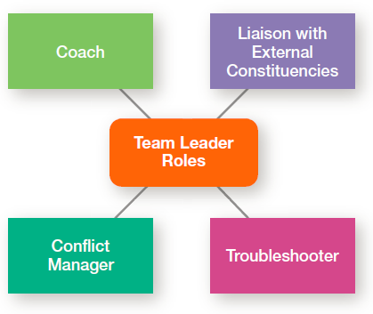
EXHIBIT 18-5 TEAM LEADERSHIP ROLES

Slide 34
LEADERSHIP ISSUES IN THE TWENTY-FIRST CENTURY
Managing Power
Legitimate power - the power a leader has as a result of his or her position.
Coercive power - the power a leader has to punish or control.
Reward power - the power to give positive benefits or rewards.
Notes:
Where do leaders get their power—that is, their right and capacity to influence work actions or decisions? Five sources of leader power have been identified: legitimate, coercive, reward, expert, and referent.
Legitimate power and authority are the same. Legitimate power represents the power a leader has as a result of his or her position in the organization. Although people in positions of authority are also likely to have reward and coercive power, legitimate power is broader than the power to coerce and reward.
Coercive power is the power a leader has to punish or control. Followers react to this power out of fear of the negative results that might occur if they don’t comply. Managers typically have some coercive power, such as being able to suspend or demote employees or to assign them work they find unpleasant or undesirable.
Reward power is the power to give positive rewards. A reward can be anything a person values such as money, favorable performance appraisals, promotions, interesting work assignments, friendly colleagues, and preferred work shifts or sales territories.

Slide 35
LEADERSHIP ISSUES IN THE TWENTY-FIRST CENTURY (CONT.)
Managing Power (cont.)
Expert power - the influence a leader can exert as a result of his or her expertise, skills, or knowledge.
Referent power - the power of a leader that arises because of a person’s desirable resources or admired personal traits
Notes:
Expert power is power based on expertise, special skills, or knowledge. If an employee has skills, knowledge, or expertise that’s critical to a work group, that person’s expert power is enhanced.
Finally, referent power is the power that arises because of a person’s desirable resources or personal traits. If I admire you and want to be associated with you, you can exercise power over me because I want to please you. Referent power develops out of admiration of another and a desire to be like that person.

Slide 36
LEADERSHIP ISSUES IN THE TWENTY-FIRST CENTURY (CONT.)
Developing Trust
Credibility - the degree to which followers perceive someone as honest, competent, and able to inspire
Trust - the belief in the integrity, character, and ability of a leader
Notes:
“Honesty is absolutely essential to leadership. If people are going to follow someone willingly, whether it be into battle or into the boardroom, they first want to assure themselves that the person is worthy of their trust.” In addition to being honest, credible leaders are competent and inspiring. They are personally able to effectively communicate their confidence and enthusiasm. Thus, followers judge a leader’s credibility in terms of his or her honesty, competence, and ability to inspire.
Trust is closely entwined with the concept of credibility, and, in fact, the terms are often used interchangeably. Trust is defined as the belief in the integrity, character, and ability of a leader. Followers who trust a leader are willing to be vulnerable to the leader’s actions because they are confident that their rights and interests will not be abused.

Slide 37
LEADERSHIP ISSUES IN THE TWENTY-FIRST CENTURY (CONT.)
Five dimensions of trust
Integrity: honesty and truthfulness
Competence: technical and interpersonal knowledge and skills
Consistency: reliability, predictability, and good judgment in handling situations
Loyalty: willingness to protect a person, physically and emotionally
Openness: willingness to share ideas and information freely
Notes:
Research has identified five dimensions that make up the concept of trust:
• Integrity: honesty and truthfulness
• Competence: technical and interpersonal knowledge and skills
• Consistency: reliability, predictability, and good judgment in handling situations
• Loyalty: willingness to protect a person, physically and emotionally
• Openness: willingness to share ideas and information freely
Of these five dimensions, integrity seems to be the most critical when someone assesses another’s trustworthiness.

Slide 38
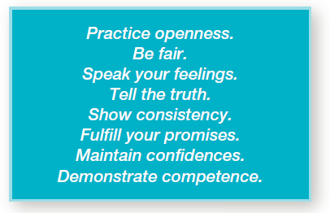
EXHIBIT 18-6 BUILDING TRUST
Notes:
Given the importance of trust to effective leadership, how can leaders build trust? Exhibit 18-6 lists some suggestions. (Also, see the Building Your Skill exercise in Chapter 5.)

Slide 39
LEADERSHIP ISSUES IN THE TWENTY-FIRST CENTURY (CONT.)
Empowering Employees
Empowerment - increasing the decision-making discretion of workers such that teams can make key operating decisions in developing budgets, scheduling workloads, controlling inventories, and solving quality problems.
Notes:
As we’ve described in different places throughout the text, managers are increasingly leading by empowering their employees. As we’ve said before, empowerment involves increasing the decision-making discretion of workers. Millions of individual employees and employee teams are making the key operating decisions that directly affect their work. They’re developing budgets, scheduling workloads, controlling inventories,
solving quality problems, and engaging in similar activities that until very recently were viewed exclusively as part of the manager’s job.

Slide 40
LEADERSHIP ISSUES IN THE TWENTY-FIRST CENTURY (CONT.)
Leading Across Cultures
Effective leaders do not use a single style. They adjust their style to the situation.
National culture is certainly an important situational variable in determining which leadership style will be most effective
Notes:
One general conclusion that surfaces from leadership research is that effective leaders do not use a single style. They adjust their style to the situation. Although not mentioned explicitly, national culture is certainly an important situational variable in determining which leadership style will be most effective. What works in China isn’t likely to be effective in France or Canada. For instance, one study of Asian leadership
styles revealed that Asian managers preferred leaders who were competent decision makers, effective communicators, and supportive of employees.
National culture affects leadership style because it influences how followers will respond. Leaders can’t (and shouldn’t) just choose their styles randomly. They’re constrained by the cultural conditions their followers have come to expect.

Slide 41
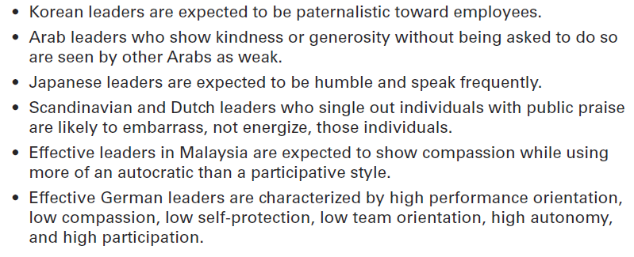
EXHIBIT 18-7 CROSS-CULTURAL LEADERSHIP
Notes:
Exhibit 18-7 provides some findings from selected examples of cross-cultural leadership studies. Because most leadership theories were developed in the United States, they have an American bias.

Slide 42
BECOMING AN EFFECTIVE LEADER
Leader Training
Training is more likely to be successful with individuals who are high self-monitors than those who are low self-monitors.
Individuals with higher levels of motivation to lead are more receptive to leadership development opportunities.
Notes:
Evidence indicates that leadership training is more likely to be successful with individuals who are high self-monitors than with low self-monitors.
Such individuals have the flexibility to change their behavior as different situations may require. In addition, organizations may find that individuals with higher levels of a trait called motivation to lead are more receptive to leadership development opportunities.

Slide 43
REVIEW LEARNING OUTCOME 18.1
Define leader and leadership.
A leader is someone who can influence others and who has managerial authority.
Leadership is a process of leading a group and influencing that group to achieve its goals.
Managers should be leaders because leading is one of the four management functions.
Notes:
A leader is someone who can influence others and who has managerial authority. Leadership is a process of leading a group and influencing that group to achieve its goals. Managers should be leaders because leading is one of the four management functions.

Slide 44
REVIEW LEARNING OUTCOME 18.2
Compare and contrast early theories of leadership.
The University of Iowa studies explored three leadership styles.
The Ohio State studies identified two dimensions of leader behavior—initiating structure and consideration.
The University of Michigan studies looked at employee-oriented leaders and production-oriented leaders.
Notes:
Early attempts to define leader traits were unsuccessful although later attempts found seven traits associated with leadership. The University of Iowa studies explored three leadership styles. The only conclusion was that group members were more satisfied under a democratic
leader than under an autocratic one.
The Ohio State studies identified two dimensions of leader behavior—initiating structure and consideration. A leader high in both those dimensions at times achieved high group task performance and high group member satisfaction, but not always.
The University of Michigan studies looked at employee-oriented leaders and production-oriented leaders. They concluded that leaders who were employee oriented could get high group productivity and high group member satisfaction.

Slide 45
REVIEW LEARNING OUTCOME 18.2 (CONT.)
The Managerial Grid looked at leaders’ concern for production and concern for people and identified five leader styles.
The behavioral studies suggest that a leader’s behavior has a dual nature: a focus on the task and a focus on the people.
Notes:
The Managerial Grid looked at leaders’ concern for production and concern for people and identified five leader styles. Although it suggested that a leader who was high in concern for production and high in concern for people was the best, there was no substantive evidence for that conclusion. As the behavioral studies showed, a leader’s behavior has a dual nature: a focus on the task and a focus on the people.

Slide 46
REVIEW LEARNING OUTCOME 18.3
Describe the three major contingency theories of leadership.
Fiedler’s model attempted to define the best style to use in particular situations.
Hersey and Blanchard’s situational leadership theory focused on followers’ readiness.
The path-goal model developed by Robert House identified four leadership behaviors: directive, supportive, participative, and achievement-oriented.
Notes:
Fiedler’s model attempted to define the best style to use in particular situations. He measured leader style—relationship oriented or task oriented—using the least-preferred coworker questionnaire. Fiedler also assumed a leader’s style was fixed. He measured three contingency dimensions: leader–member relations, task structure, and position power. The model suggests that task oriented leaders performed best in very favorable and very unfavorable situations, and relationship-oriented leaders performed best in moderately favorable situations.
Hersey and Blanchard’s situational leadership theory focused on followers’ readiness. They identified four leadership styles: telling (high task–low relationship), selling (high task–high relationship), participating (low task–high relationship), and delegating (low task–low relationship). They also identified four stages of readiness: unable and unwilling (use telling style), unable but willing (use selling style), able but unwilling (use participative style), and able and willing (use delegating style).
The path-goal model developed by Robert House identified four leadership behaviors: directive, supportive, participative, and achievement-oriented. He assumed that a leader can and should be able to use any of these styles. The two situational contingency variables were found in the environment and in the follower. Essentially the path-goal model says that a leader should provide direction and support as needed; that is, structure the path so the followers can achieve goals.

Slide 47
REVIEW LEARNING OUTCOME 18.4
Describe contemporary views of leadership.
Leader–member exchange theory (LMX) says that those in the in-group will have higher performance ratings, less turnover, and greater job satisfaction.
A transactional leader exchanges rewards for productivity
A transformational leader stimulates and inspires followers to achieve goals.
Notes:
Leader–member exchange theory (LMX) says that leaders create in-groups and outgroups and those in the in-group will have higher performance ratings, less turnover, and greater job satisfaction. A transactional leader exchanges rewards for productivity where a transformational leader stimulates and inspires followers to achieve goals.

Slide 48
REVIEW LEARNING OUTCOME 18.4 (CONT.)
A charismatic leader is an enthusiastic and self-confident leader whose personality and actions influence people to behave in certain ways.
A visionary leader is able to create and articulate a realistic, credible, and attractive vision of the future.
A team leader has two priorities: manage the team’s external boundary and facilitate the team process.
Notes:
A charismatic leader is an enthusiastic and self-confident leader whose personality and actions influence people to behave in certain ways. People can learn to be charismatic. A visionary leader is able to create and articulate a realistic, credible, and attractive vision of the future.
A team leader has two priorities: manage the team’s external boundary and facilitate the team process. Four leader roles are involved: liaison with external constituencies, troubleshooter, conflict manager, and coach.

Slide 49
REVIEW LEARNING OUTCOME 18.5
Discuss contemporary issues affecting leadership.
The five sources of a leader’s power are legitimate, coercive, reward, expert,, and referent.
Today’s leaders face the issues of managing power, developing trust, empowering employees, leading across cultures, and becoming an effective leader.
Notes:
The five sources of a leader’s power are legitimate (authority or position), coercive (punish or control), reward (give positive rewards), expert (special expertise, skills, or knowledge), and referent (desirable resources or traits). Today’s leaders face the issues of managing power, developing trust, empowering employees, leading across cultures, and becoming an effective leader.

Slide 50

ANY QUESTION?

Slide 51

END OF LESSON

